Slide 1


Stavros Karakepelis
April 5, 2024

Slide 2

Outline
Executive Summary
Introduction
Methodology
Results
Conclusion
Appendix

Slide 3
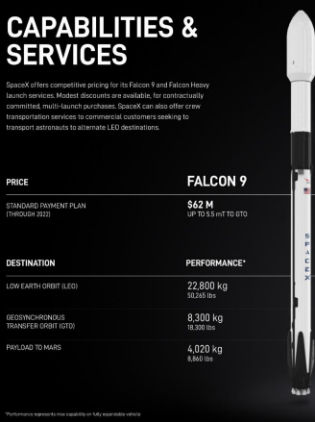
Executive Summary
SpaceY is a new commercial rocket launch provider who wants to bid against SpaceX.
SpaceX advertises launch services starting at $62 million for missions that allow some fuel to be reserved for landing the 1st stage rocket booster, so that it can be reused.
SpaceX public statements indicate a 1st stage Falcon 9 booster to cost upwards of $15 million to build without including R&D cost recoupment or profit margin.
Given mission parameters such as payload mass and desired orbit, the models produced in this report were able to predict the first stage rocket booster landing successfully with an accuracy level of 83.3%.
As a result, SpaceY will be able to make more informed bids against SpaceX by using 1st stage landing predictions as a proxy for the cost of a launch.

Slide 4

Introduction
SpaceX advertises Falcon 9 rocket launches with a cost of 62 million dollars when the first stage of their rockets can be reused.
The first stage is estimated to cost upwards of 15 million to build without including R&D cost recoupment or profit margin.
Sometimes SpaceX will sacrifice the first stage due to mission parameters such as payload, orbit, and customer.
Therefore, this report aims to accurately predict the likelihood of the first stage rocket landing successfully as a proxy for the cost of a launch.

Slide 5

Section 1

Slide 6
Methodology
Executive Summary
Data collection
Data wrangling
Exploratory data analysis (EDA)
Data visualization and analytics
Predictive analysis using ML models
Report results to stakeholders

Slide 7
Data Collection - SpaceX API
API method
Acquired historical launch data from Open Source REST API for SpaceX
Requested and parsed the SpaceX launch data using the GET request
Filtered the dataframe to only include Falcon 9 launches
Replaced missing payload mass values from classified missions with mean

Slide 8
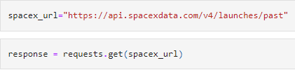
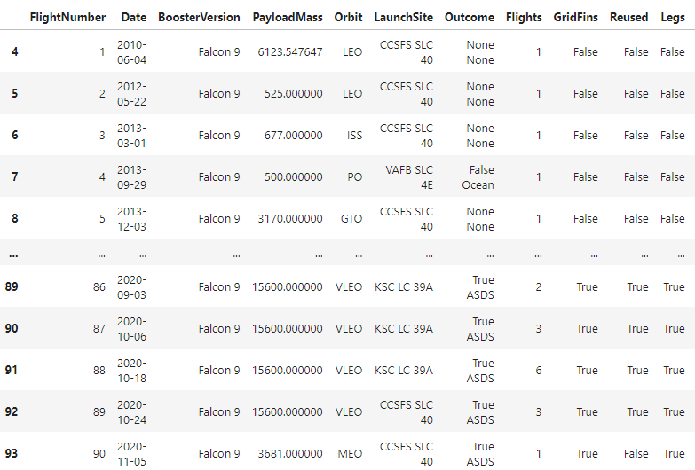
Data Collection – SpaceX API
GitHub: https://github.com/skarakepelis/edX_DS_Capstone_Project/blob/main/Module%201%20-%20Capstone%20Introduction%20and%20Understanding%20the%20Datasets/jupyter-labs-spacex-data-collection-api.ipynb

Slide 9
Data Collection – Web Scraping
Web Scraping
Acquired historical launch data from Wikipedia page 'List of Falcon 9 and Falcon Heavy Launches' Requested the Falcon9 Launch Wiki page from its Wikipedia URL
Extracted all column/variable names from the HTML table header
Parsed the table and converted it into a Pandas data frame

Slide 10
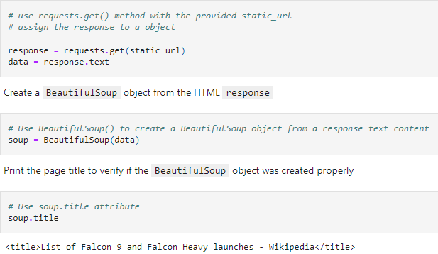
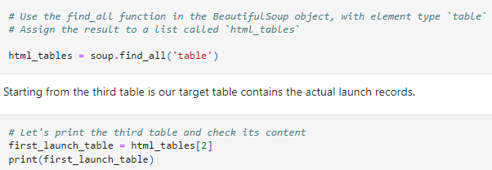
Data Collection – Web Scraping
GitHub:
https://github.com/skarakepelis/edX_DS_Capstone_Project/blob/main/Module%201%20-%20Capstone%20Introduction%20and%20Understanding%20the%20Datasets/jupyter-labs-webscraping.ipynb

Slide 11
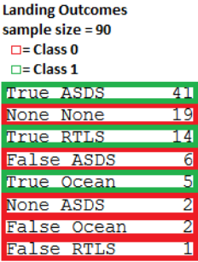
Data Wrangling
Data Wrangling
• Explored data to determine the label for training supervised models
• Calculated the number of launches on each site
• Calculated the number and occurrence of each orbit
• Calculated the number and occurrence of mission outcome per orbit type
• Created a landing outcome training label from 'Outcome' column
• Training label: 'Class'
• Class = 0; first stage booster did not land successfully
• None None; not attempted
• None ASDS; unable to be attempted due to launch failure
• False ASDS; drone ship landing failed
• False Ocean; ocean landing failed
• False RTLS; ground pad landing failed
• Class = 1; first stage booster landed successfully
• True ASDS; drone ship landing succeeded
• True RTLS; ground pad landing succeeded
• True Ocean; ocean landing succeeded
GitHub:
https://github.com/skarakepelis/edX_DS_Capstone_Project/blob/main/Module%201%20-%20Capstone%20Introduction%20and%20Understanding%20the%20Datasets/labs-jupyter-spacex-data_wrangling_jupyterlite.jupyterlite.ipynb

Slide 12
EDA with SQL
• Loaded data into a db instance called “my_data1.db”
• Ran SQL queries to display and list information about
• Launch sites
• Payload masses
• Booster versions
• Mission outcomes
• Booster landings
GitHub: https://github.com/skarakepelis/edX_DS_Capstone_Project/blob/main/Module%202%20-%20Exploratory%20Data%20Analysis%20(EDA)/jupyter-labs-eda-sql-edx_sqllite.ipynb

Slide 13
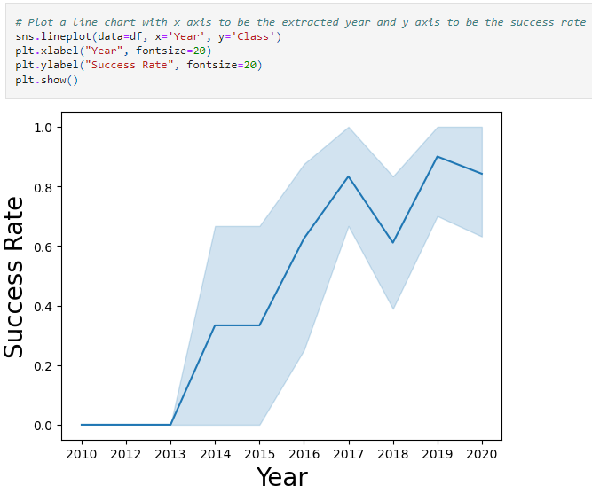
EDA with Data Visualization
Read the dataset into a Pandas dataframe
Used Matplotlib and Seaborn visualization libraries to plot
FlightNumber x PayloadMass
FlightNumber x LaunchSite
Payload x LaunchSite
Orbit type x Success rate
FlightNumber x Orbit type
Payload x Orbit type
Year x Success Rate
GitHub: https://github.com/skarakepelis/edX_DS_Capstone_Project/blob/main/Module%202%20-%20Exploratory%20Data%20Analysis%20(EDA)/jupyter-labs-eda-dataviz.ipynb.jupyterlite.ipynb

Slide 14
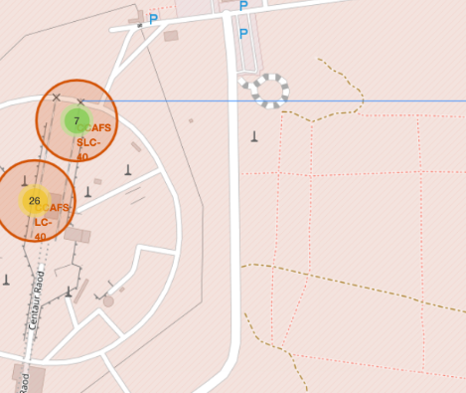
Build an Interactive Map with Folium
Used Python interactive mapping library called Folium
Marked all launch sites on a map
Marked the successful/failed launches for each site on map
Calculated the distances between a launch site to its proximities
Railways
Highways
Coastlines
Cities
GitHub: https://github.com/skarakepelis/edX_DS_Capstone_Project/blob/main/Module%203%20-%20Interactive%20Visual%20Analytics%20and%20Dashboard/lab_jupyter_launch_site_location.jupyterlite.ipynb

Slide 15
Build a Dashboard with Plotly Dash
Used Python interactive dashboarding library called Plotly Dash to enable stakeholders to explore and manipulate data in an interactive and real-time way
Pie chart showing success rate
Color coded by launch site
Scatter chart showing payload mass vs. landing outcome
Color coded by booster version
With range slider for limiting payload amount
Drop-down menu to choose between all sites and individual launch sites
GitHub: https://github.com/skarakepelis/edX_DS_Capstone_Project/blob/main/Module%203%20-%20Interactive%20Visual%20Analytics%20and%20Dashboard/spacex_dash_app.py

Slide 16
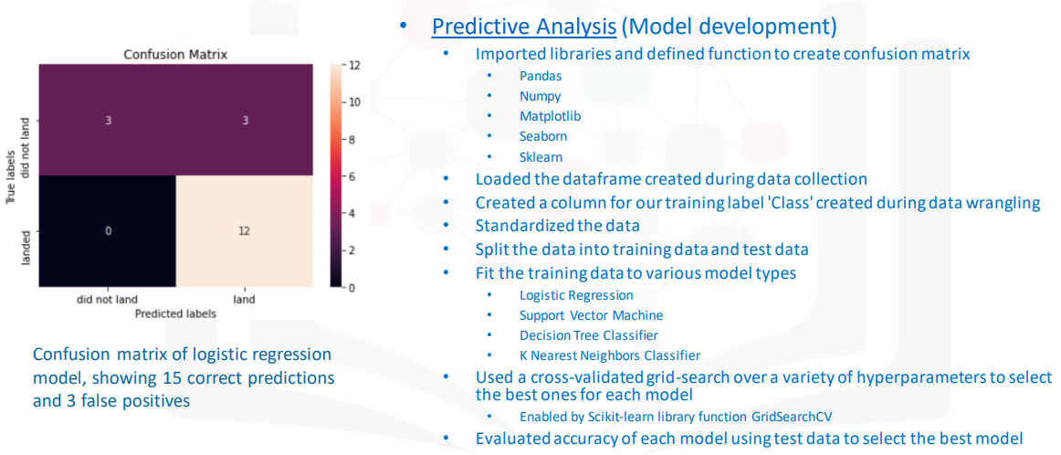
Predictive Analysis (Classification)

Slide 17
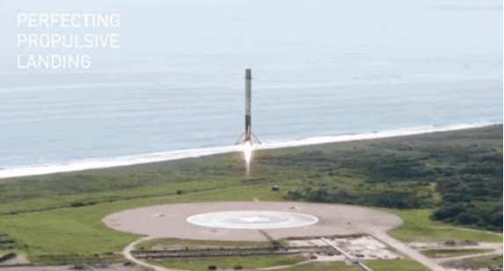
Results
Exploratory data analysis results
Interactive analytics demo in screenshots
Predictive analysis results

Slide 18

Section 2

Slide 19
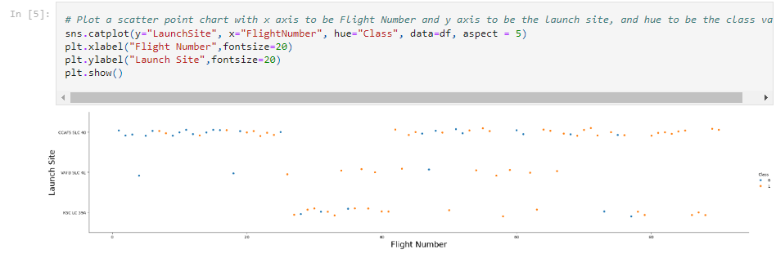
Flight Number vs. Launch Site

Slide 20
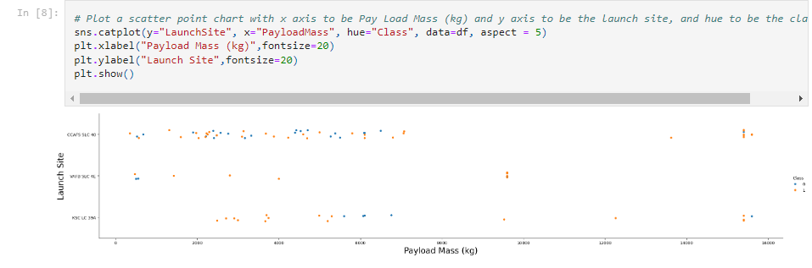
Payload vs. Launch Site

Slide 21
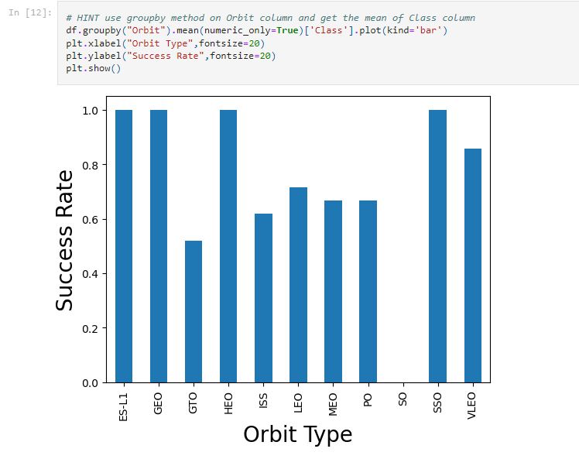
Success Rate vs. Orbit Type

Slide 22
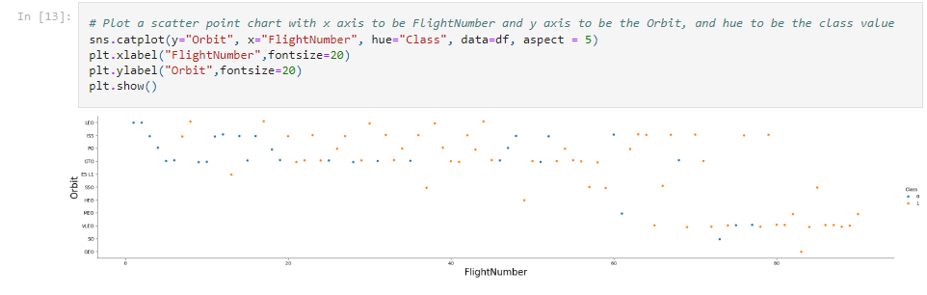
Flight Number vs. Orbit Type

Slide 23
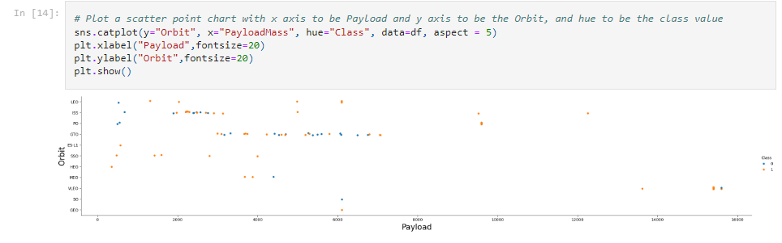
Payload vs. Orbit Type

Slide 24
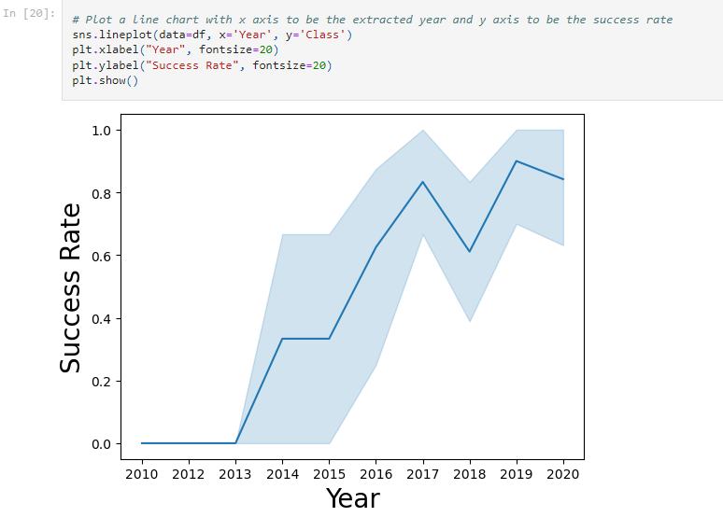
Launch Success Yearly Trend

Slide 25
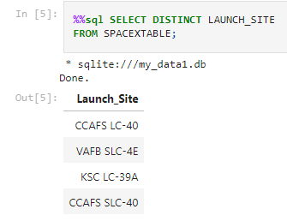
All Launch Site Names

Slide 26
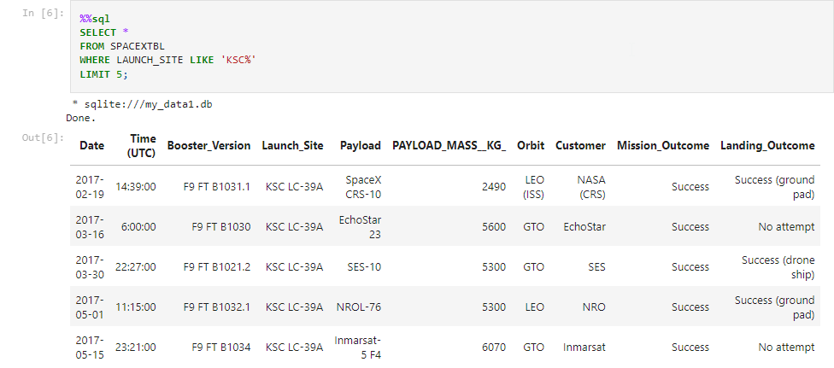
Launch Site Names Begin with 'KSC'

Slide 27
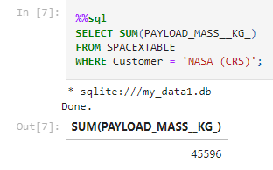
Total Payload Mass

Slide 28
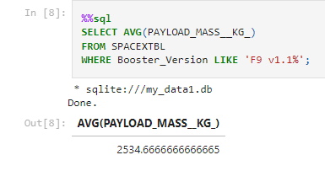
Average Payload Mass by F9 v1.1

Slide 29
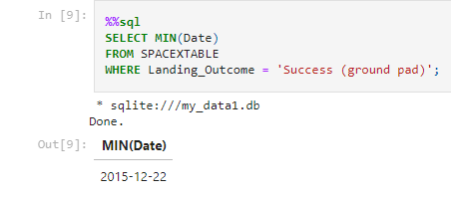
First Successful Ground Landing Date

Slide 30
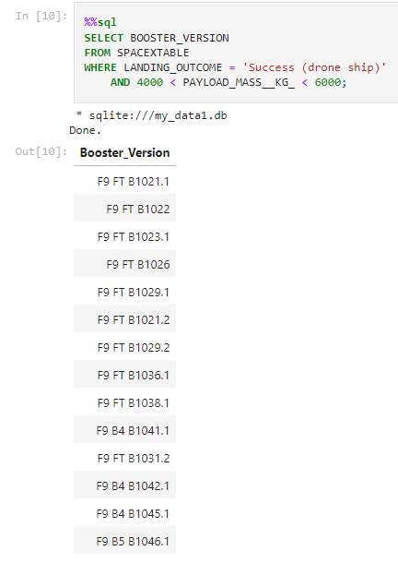
Successful Drone Ship Landing with Payload between 4000 and 6000

Slide 31
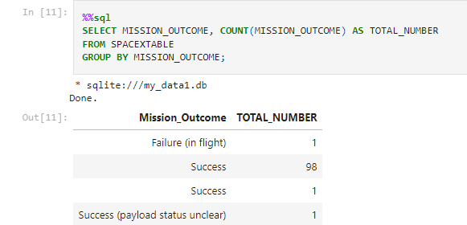
Total Number of Successful and Failure Mission Outcomes

Slide 32
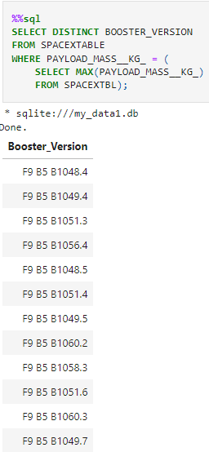
Boosters Carried Maximum Payload

Slide 33
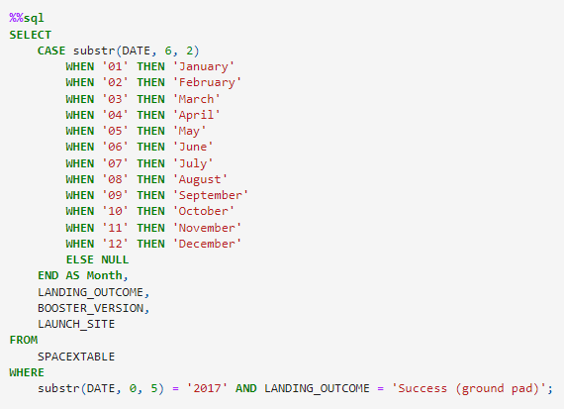
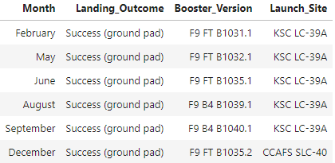
2017 Launch Records

Slide 34
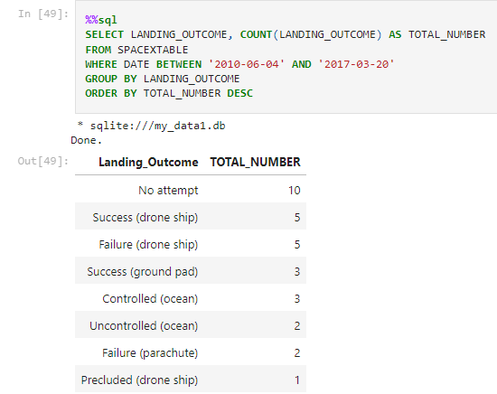
Rank Landing Outcomes Between 2010-06-04 and 2017-03-20

Slide 35

Section 3

Slide 36
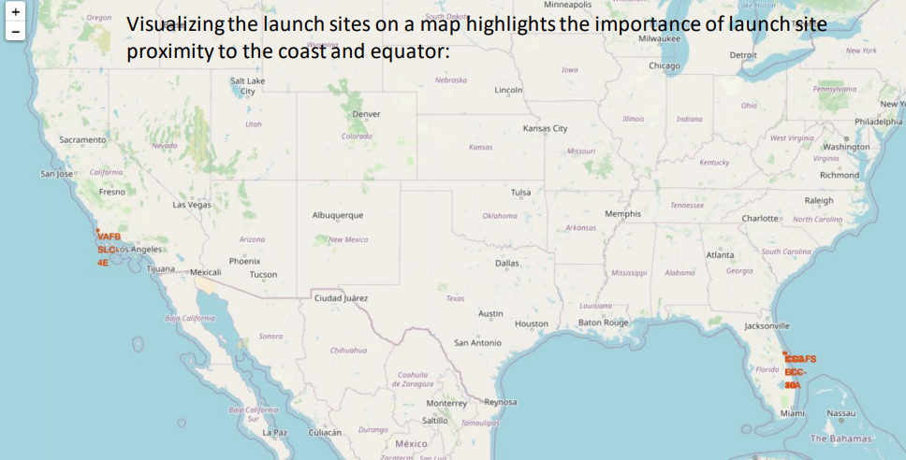
Launch Site Location Analysis (1/3)

Slide 37
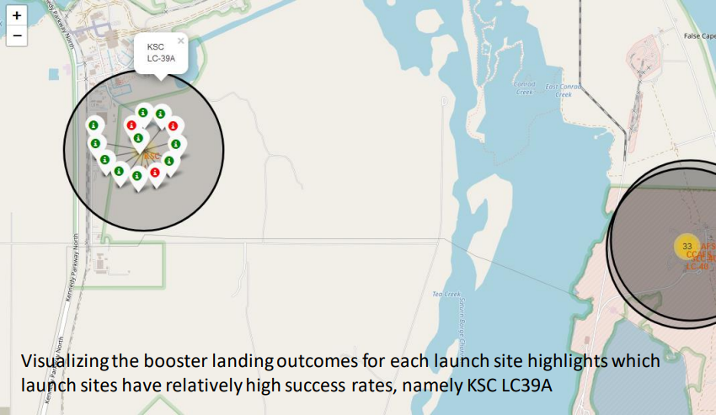
Launch Site Location Analysis (2/3)

Slide 38
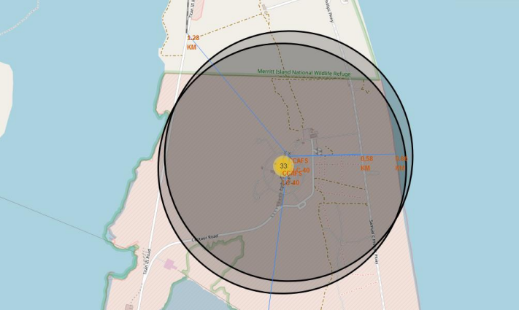
Launch Site Location Analysis (3/3)

Slide 39

Section 4

Slide 40
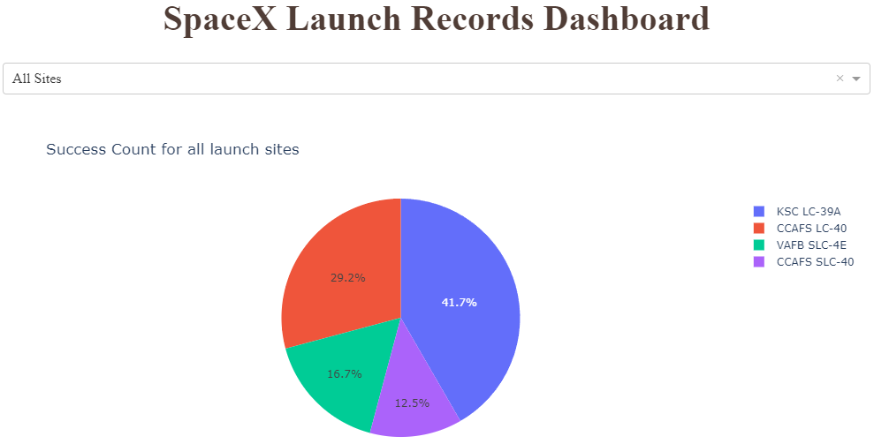
SpaceX Launch Records Dashboard – All Sites

Slide 41
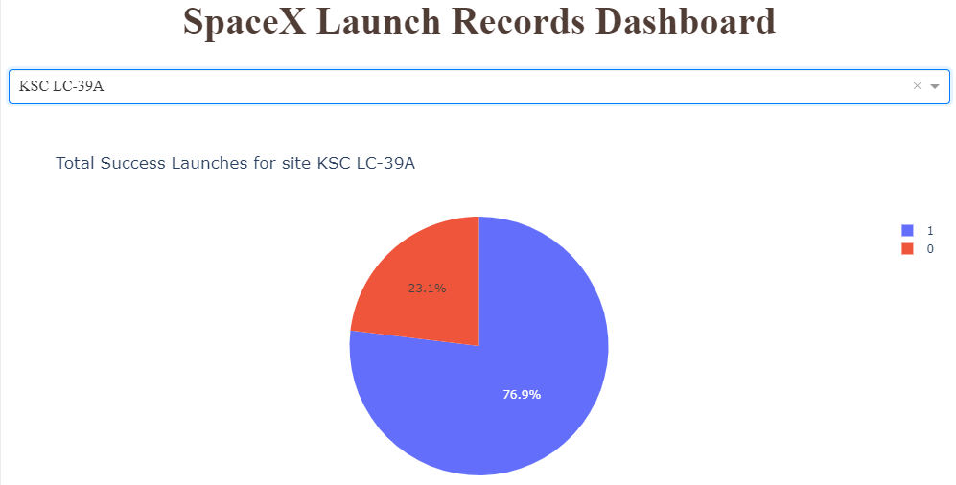
SpaceX Launch Records Dashboard – KSC LC-39A

Slide 42
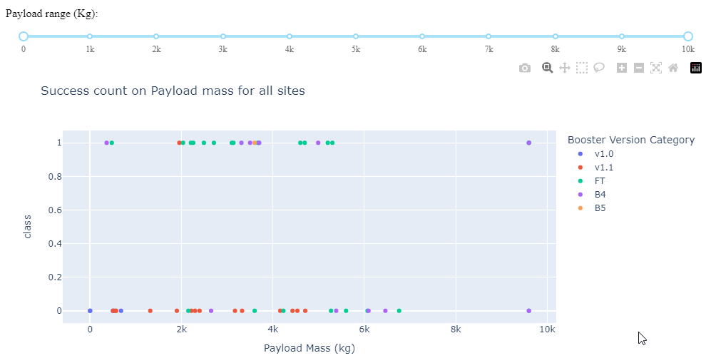
SpaceX Launch Records Dashboard – Payload vs Launch Outcome

Slide 43

Section 5

Slide 44
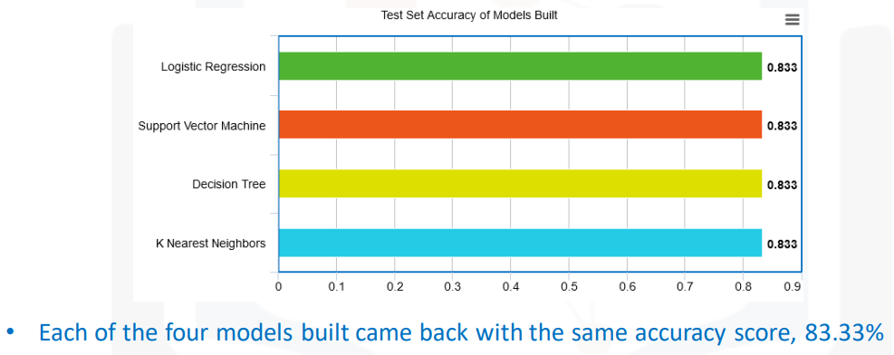
Classification Accuracy

Slide 45

Confusion Matrix
Pretty much all the models return an accuracy score of 83.33%
The major problem is false positives as evidenced by the models, incorrectly predicting the first stage booster to land in 3/18 samples in the test set

Slide 46
Conclusions
Using the models from this report SpaceY can predict when SpaceX will successfully land the 1st
stage booster with 83.3% accuracy
SpaceX public statements indicate the 1st stage booster costs upwards of $15 million to build
This will enable SpaceY to make more informed bids against SpaceX, since they will have a good
idea when to expect the SpaceX bid to include the cost of a sacrificed 1st stage booster
With a list price of $62 million per launch, sacrificing the $15+ million 1st stage, would put the
SpaceX bid at upwards of $77 million
Biggest opportunities going forward to make even more informed bids:
Freeze the best performing combination of model and hyperparameters and re-fit using the whole dataset
instead of just the training data
Potentially better than using only part of the data to fit the model, but you would no longer be able to measure the accuracy of
the resulting model
Incorporate additional launch data to the dataset and model as it becomes available
Subdivide the current model into two models
Predict if SpaceX will ATTEMPT to land the 1st stage
Predict if SpaceX will SUCCEED in their attempt
Create a related model that predicts if SpaceX will launch using a previously-flown 1st stage booster
Would enable SpaceY to take into account when the SpaceX bid would likely include a discount

Slide 47
Appendix
Notebooks to recreate dataset, analysis, and models:
Module 1 - Capstone Introduction and Understanding the Datasets
https://github.com/skarakepelis/edX_DS_Capstone_Project/blob/main/Module%201%20-%20Capstone%20Introduction%20and%20Understanding%20the%20Datasets/jupyter-labs-spacex-data-collection-api.ipynb
https://github.com/skarakepelis/edX_DS_Capstone_Project/blob/main/Module%201%20-%20Capstone%20Introduction%20and%20Understanding%20the%20Datasets/jupyter-labs-webscraping.ipynb
https://github.com/skarakepelis/edX_DS_Capstone_Project/blob/main/Module%201%20-%20Capstone%20Introduction%20and%20Understanding%20the%20Datasets/labs-jupyter-spacex-data_wrangling_jupyterlite.jupyterlite.ipynb
Module 2 - Exploratory Data Analysis (EDA)
https://github.com/skarakepelis/edX_DS_Capstone_Project/blob/main/Module%202%20-%20Exploratory%20Data%20Analysis%20(EDA)/jupyter-labs-eda-dataviz.ipynb.jupyterlite.ipynb
https://github.com/skarakepelis/edX_DS_Capstone_Project/blob/main/Module%202%20-%20Exploratory%20Data%20Analysis%20(EDA)/jupyter-labs-eda-sql-edx_sqllite.ipynb
Module 3 - Interactive Visual Analytics and Dashboard
https://github.com/skarakepelis/edX_DS_Capstone_Project/blob/main/Module%203%20-%20Interactive%20Visual%20Analytics%20and%20Dashboard/lab_jupyter_launch_site_location.jupyterlite.ipynb
https://github.com/skarakepelis/edX_DS_Capstone_Project/blob/main/Module%203%20-%20Interactive%20Visual%20Analytics%20and%20Dashboard/spacex_dash_app.py
Module 4 - Predictive Analysis (Classification)
https://github.com/skarakepelis/edX_DS_Capstone_Project/blob/main/Module%204%20-%20Predictive%20Analysis%20(Classification)/SpaceX_Machine_Learning_Prediction_Part_5.jupyterlite.ipynb
Acknowledgments
Thank you to Joseph Santarcangelo at IBM for creating the course and materials
Thank you to Lakshmi Holla at IBM for the assistance provided
References
https://aviationweek.com/defense-space/space/podcast-interview-spacexs-elon-musk (Interview with Elon Musk where he discloses the 1st stage booster to cost upwards of $15 million)
https://datascience.stackexchange.com/a/33050 (Explanation of why you would rebuild your model using the full dataset)
https://www.spacex.com/vehicles/falcon-9/ (Source of SpaceX's advertised $62 million launch price)

Slide 48


